Slide 1


SMART INDIA HACKATHON 2025
TITLE PAGE
Problem Statement ID – 25041
Problem Statement Title- AI-Driven Unified Data Platform for Oceanographic, Fisheries, and Molecular Biodiversity Insights
Theme- Renewable / Sustainable Energy
PS Category- Software
Team ID- 93881
Team Name – Feature Fabricators

Slide 2
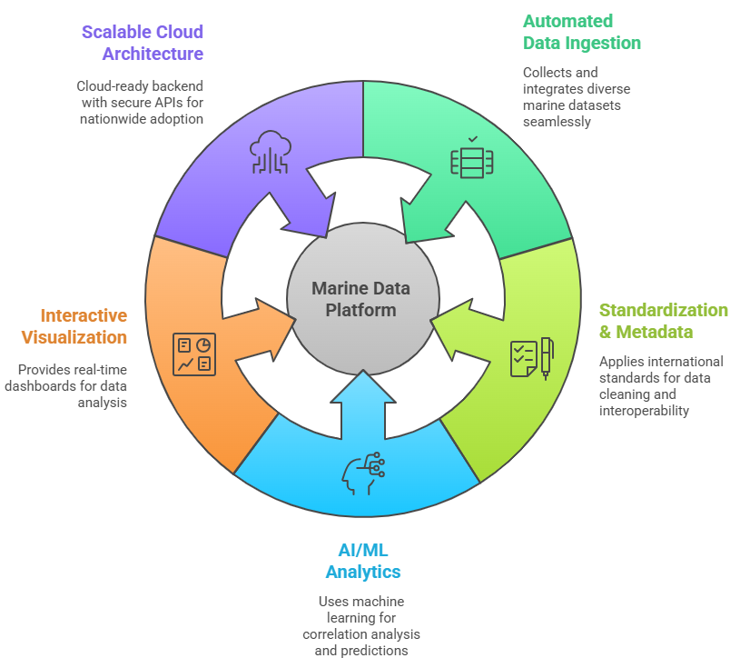
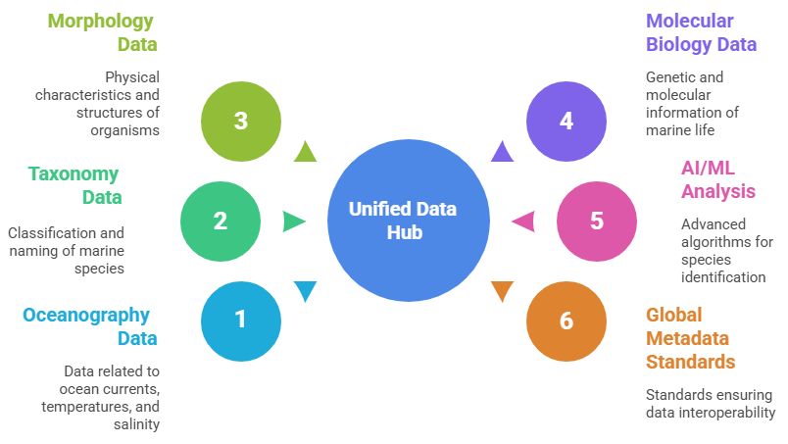
IDEA TITLE
FEATURE FABRICATORS
Proposed Solution
We propose to develop OCCEANIQ : An AI-Driven Unified Data Platform that integrates oceanographic, fisheries, and molecular biodiversity datasets into a single intelligent system.
How it Addresses the Problem
Breaks data silos by unifying heterogeneous marine datasets into a single platform.
Enables real-time monitoring and forecasting of ocean and biodiversity trends.
Simplifies access for scientists, policymakers, and conservationists.
Supports sustainable fisheries management with data-driven insights.
Improves decision-making for ecosystem health and Blue Economy initiatives.
Innovation and Uniqueness of the Solution
Automated Data Ingestion – Collects and integrates structured, semi-structured, and unstructured marine datasets seamlessly.
Standardization & Metadata – Applies international standards for data cleaning, tagging, and interoperability.
AI/ML Analytics – Uses machine learning for correlation analysis, species identification, and ecosystem predictions.
Interactive Visualization – Provides real-time dashboards and modules for otolith, taxonomy, and eDNA analysis.
Scalable Cloud Architecture – Cloud-ready backend with modular microservices and secure APIs for nationwide adoption.

Slide 3





TECHNICAL APPROACH
FEATURE
FABRICATORS
Frontend/ UI
Backend Node/Python
Backend System
Ai Agent
Researchers
Storage
Frontend
OcceanIQ
Application
Server
Students
API
LLM
Tools
* Web Search Tools
* DB search Tools
Microservice System
Flask Server
Database
Mongo DB
Collect health and marine and oceanographic data
Train For the Best Model
Vector
DB
Predict the output
Train the Model
01
02
03
04
05
06
07
08
09
Frontend
Backend
Styling
Database
Microservice
ML
LLM
Vector DB
Deployment
* React
* React icon
* Zustand
* Express
* mongoose
* Cors
* Bcrypt
* JsonwebToken
* Mongo DB
* Python
* Flsak
* Django
* Scikit Learn
* TensorFlow
* Chroma
* Docker container
* AWS
* Tailwind Css
* Lucid react
* Gemini-2.5-pro

Slide 4
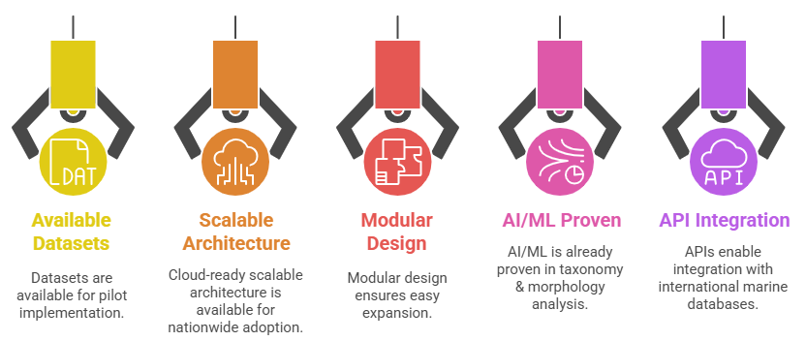
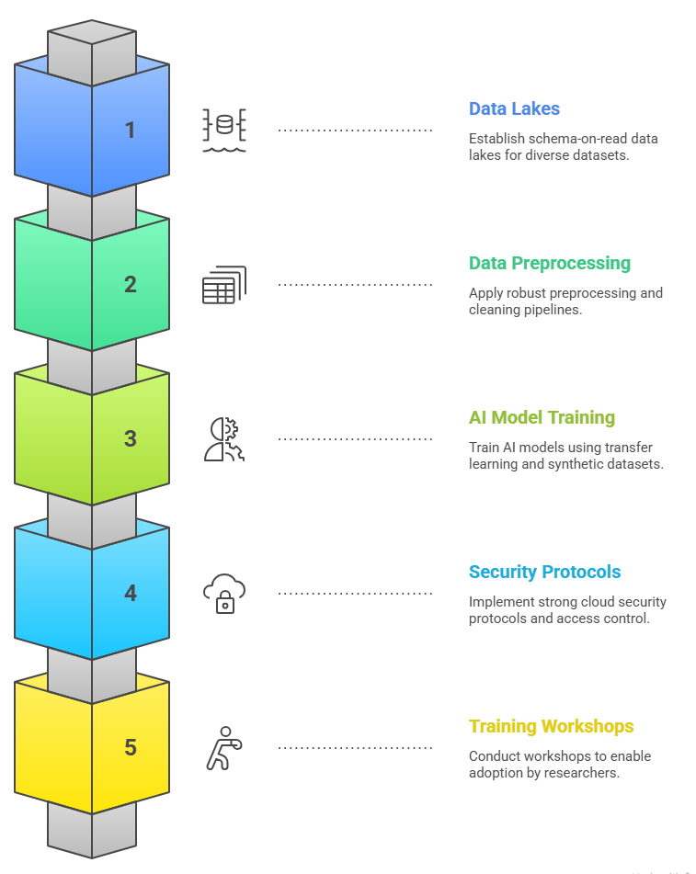
FEASIBILITY AND VIABILITY
FEATURE FABRICATORS
Feasibility:
Strategies to Overcome:
Challenges & Risks:
Handling large-scale heterogeneous data formats.
Ensuring data quality and consistency.
Limited labelled datasets for training AI/ML models.
Cloud infrastructure cost and data security concerns.
Resistance to adoption from traditional research practices.

Slide 5
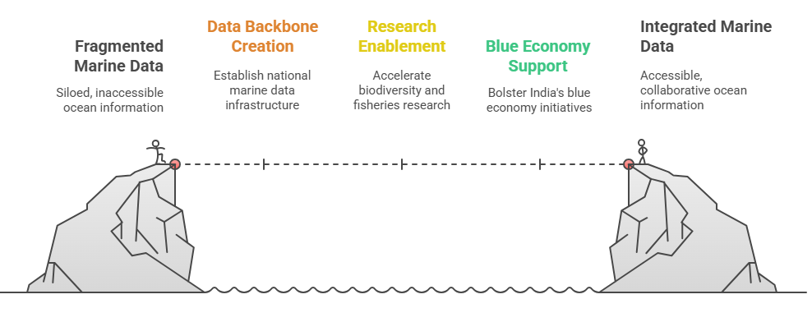
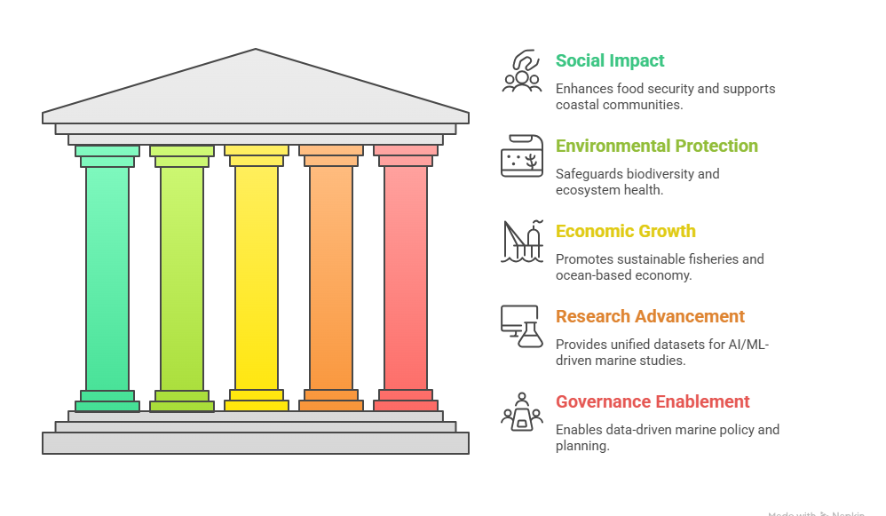
IMPACT AND BENEFITS
FEATURE FABRICATORS
Benefits:
Impact:
Social: Improves food security, supports coastal communities.
Environmental: Protects biodiversity & ecosystem health.
Economic: Boosts sustainable fisheries & ocean-based economy.
Research: Provides unified datasets for AI/ML-driven marine studies.
Governance: Enables data-driven marine policy and planning.
Establishes India’s National Marine Data Backbone.
Enables faster biodiversity and fisheries research.
Supports India’s Blue Economy initiatives.
Strengthens marine conservation and real-time climate monitoring.
Enhances global collaborations in ocean and biodiversity research.

Slide 6
RESEARCH AND REFERENCES
FEATURE FABRICATORS
CMLRE, Ministry of Earth Sciences (Mo-ES), India
Official website and marine biodiversity programs.
🔗 https://cmlre.gov.in
OBIS – Ocean Biodiversity Information System
Global open-access database for marine species and ecosystem data.
🔗 https://obis.org
FAO Fisheries and Aquaculture Department
Data standards, global statistics, and sustainable fisheries practices.
🔗 https://www.fao.org/fisheries/en/
ICES – International Council for the Exploration of the Sea
Global standards for marine biology and oceanographic data integration.
🔗 https://ices.dk
NOAA – National Oceanic and Atmospheric Administration (USA)
Research on ocean data, marine ecosystems, and climate analysis.
🔗 https://www.noaa.gov
Research Papers:
Environmental DNA (eDNA) as a Tool for Marine Biodiversity Monitoring – Nature Ecology & Evolution (2021)
🔗 https://www.nature.com/articles/s41559-021-01498-6
Deep Learning for Fish Otolith Shape Classification – Frontiers in Marine Science (2022)
🔗 https://www.frontiersin.org/articles/10.3389/fmars.2022.890765/full
AI and Big Data in Oceanography: Towards an Integrated Marine Data Framework – Marine Data Science Journal (2023)
🔗 https://www.sciencedirect.com/journal/marine-data-science
Data Standards & Frameworks:
Darwin Core Standard (DwC): https://dwc.tdwg.org/
OBIS Schema & Guidelines: https://manual.obis.org/
INSPIRE Marine Data Specifications (EU): https://inspire.ec.europa.eu/theme/ocean

